Slide 1
Project Milestone Update
James Zhan

Slide 2
Goal: Single-Frame Object Detector vs. Multi-Frame Object Detector for vehicles
Research question: Does using consecutive frames improve vehicle detection enough to justify the additional computational cost?
Comparison: Single-frame YOLO26 versus a temporal detector using neighboring frames.
Detection quality: Measure precision, recall, F1, and mAP, with attention to small or partially occluded vehicles.
Computational Cost: Predictions latency, frame latency, throughput, and peak GPU memory

Slide 3
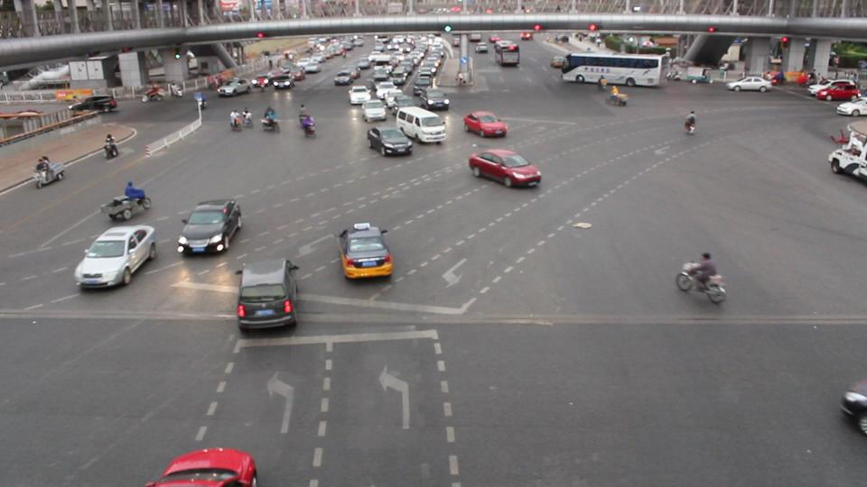
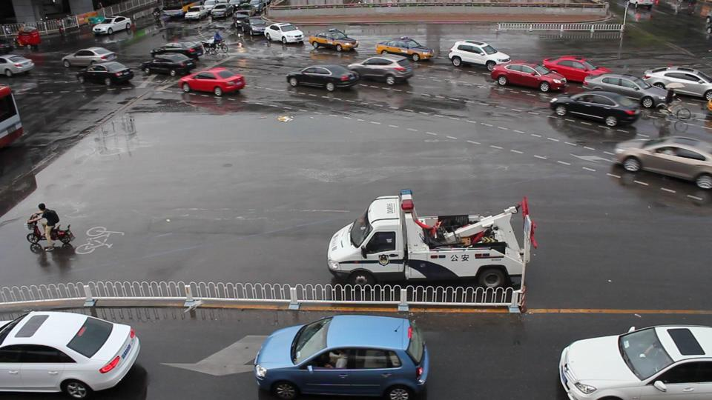
Dataset
Literature Review on public dataset
UA-DETRAC dataset
  Longyin Wen, Dawei Du, Zhaowei Cai, Zhen Lei, Ming-Ching Chang, Honggang Qi, Jongwoo Lim, Ming-Hsuan Yang, Siwei Lyu, "UA-DETRAC: A New Benchmark and Protocol for Multi-Object Detection and Tracking", Computer Vision and Image Understanding (CVIU), 2020.
  Sequential data of traffic style videos
  ~42,000 images
  ~530,000 bounding boxes
  Car, bus, van, and others all combined into vehicle class

Slide 4
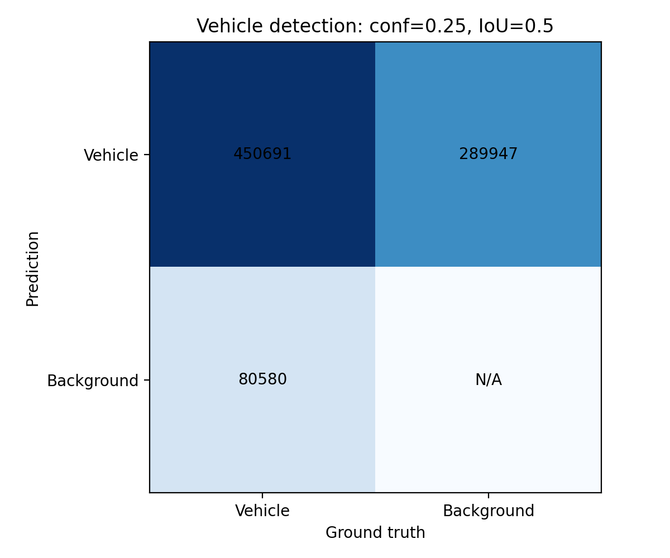
YOLOv26m Detection Metrics on UA-DETRAC
~61% Precision
  About 61 out of 100 detected vehicles are actually vehicles
~ 84% Recall
  Around 85 out of 100 vehicles are detected
~71% F1 score
  Combined Precision and Recall score
Overall average. Not bad but not good

Slide 5
Computational Metrics
Mean frame-processing latency: 13.18 ms/frame — Time to load an image, generate detections, and copy output boxes to CPU.
Frame-processing throughput: 75.88 frames/second — Number of target frames processed per second.
Peak allocated GPU memory: 159 MiB — Maximum GPU memory used by PyTorch tensors, including model weights.
Comparison setup: Evaluate both models on the same target frames and hardware; include reference-frame processing for the multi-frame model.
YOLO26 provides a fast and computationally efficient baseline for vehicle detection; it processes frames quickly with relatively low GPU-memory usage

Slide 6
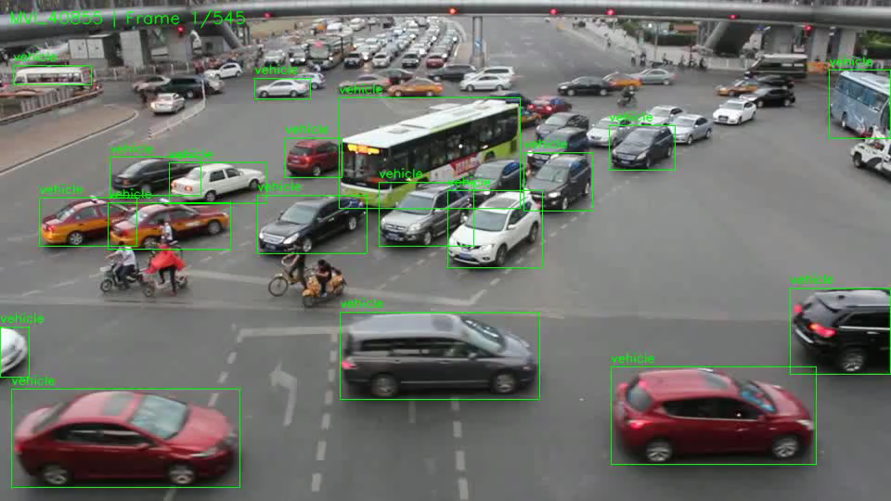
Example Sequence

Slide 7
Next Steps
Literature Review on YOLOv26 multi-frame model
  Shi, Y., Wang, N., & Guo, X. (2023). “YOLOV: Making Still Image Object Detectors Great at Video Object Detection.” AAAI.
  He et al. (2021). “End-to-End Video Object Detection with Spatial-Temporal Transformers.” ACM Multimedia.
Run the models and repeat performance metrics and computational cost

